Slide 1

Pentris bots
Group 25
Notes:
Introduce group
ALI

Slide 2

Game
Objective
Scoring
This Photo by Unknown Author is licensed under CC BY-SA-NC
Notes:
Objective: get the highest score by clearing as many rows as possible and trying to clear as many rows at once as possible
Scoring: each cleared row gives 100 points, but when you clear multiple rows at once you get +100*rowNumber
ALI

Slide 3
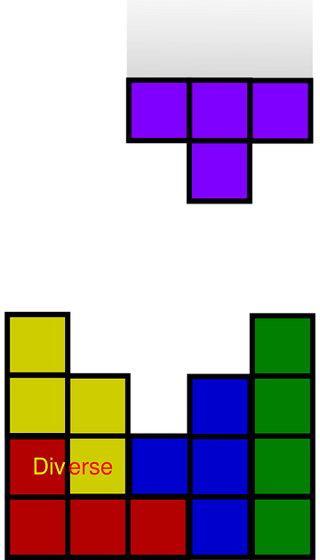
Optimal order
Approach
Algorithm X as a start
Play the game with the given orders
Results
Notes:
Use algorithm X to find ways to fill the desired space completely
Try to use the pieces in an order to fill in that desired space
We didn’t use the ‘score’ multiplier
DRAGO

Slide 4

Bots
Q-bot
G-bot
This Photo by Unknown Author is licensed under CC BY-SA
Notes:
We split the group up into two sub-groups each working on their bot. This was done so that we could try a simpler and more complex approach and everyone could still work on something and learn.
DRAGO

Slide 5
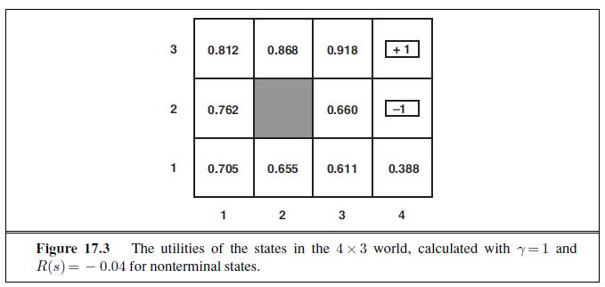
Q-bot
This Photo by Unknown Author is licensed under CC BY-SA
amountOfBlocksSurrounding * (5 * (i + 1)) + 25 * (i) + amountOfBlocksInRow * (3 * (i) + 3) + 1;
Notes:
The Q-bot works by giving every cell in the board a value that represents how useful it would be to fill that cell. It than tries to place a block in such a way that it gives the highest sum of these values.
Explain the scoring system
RENÉ

Slide 6
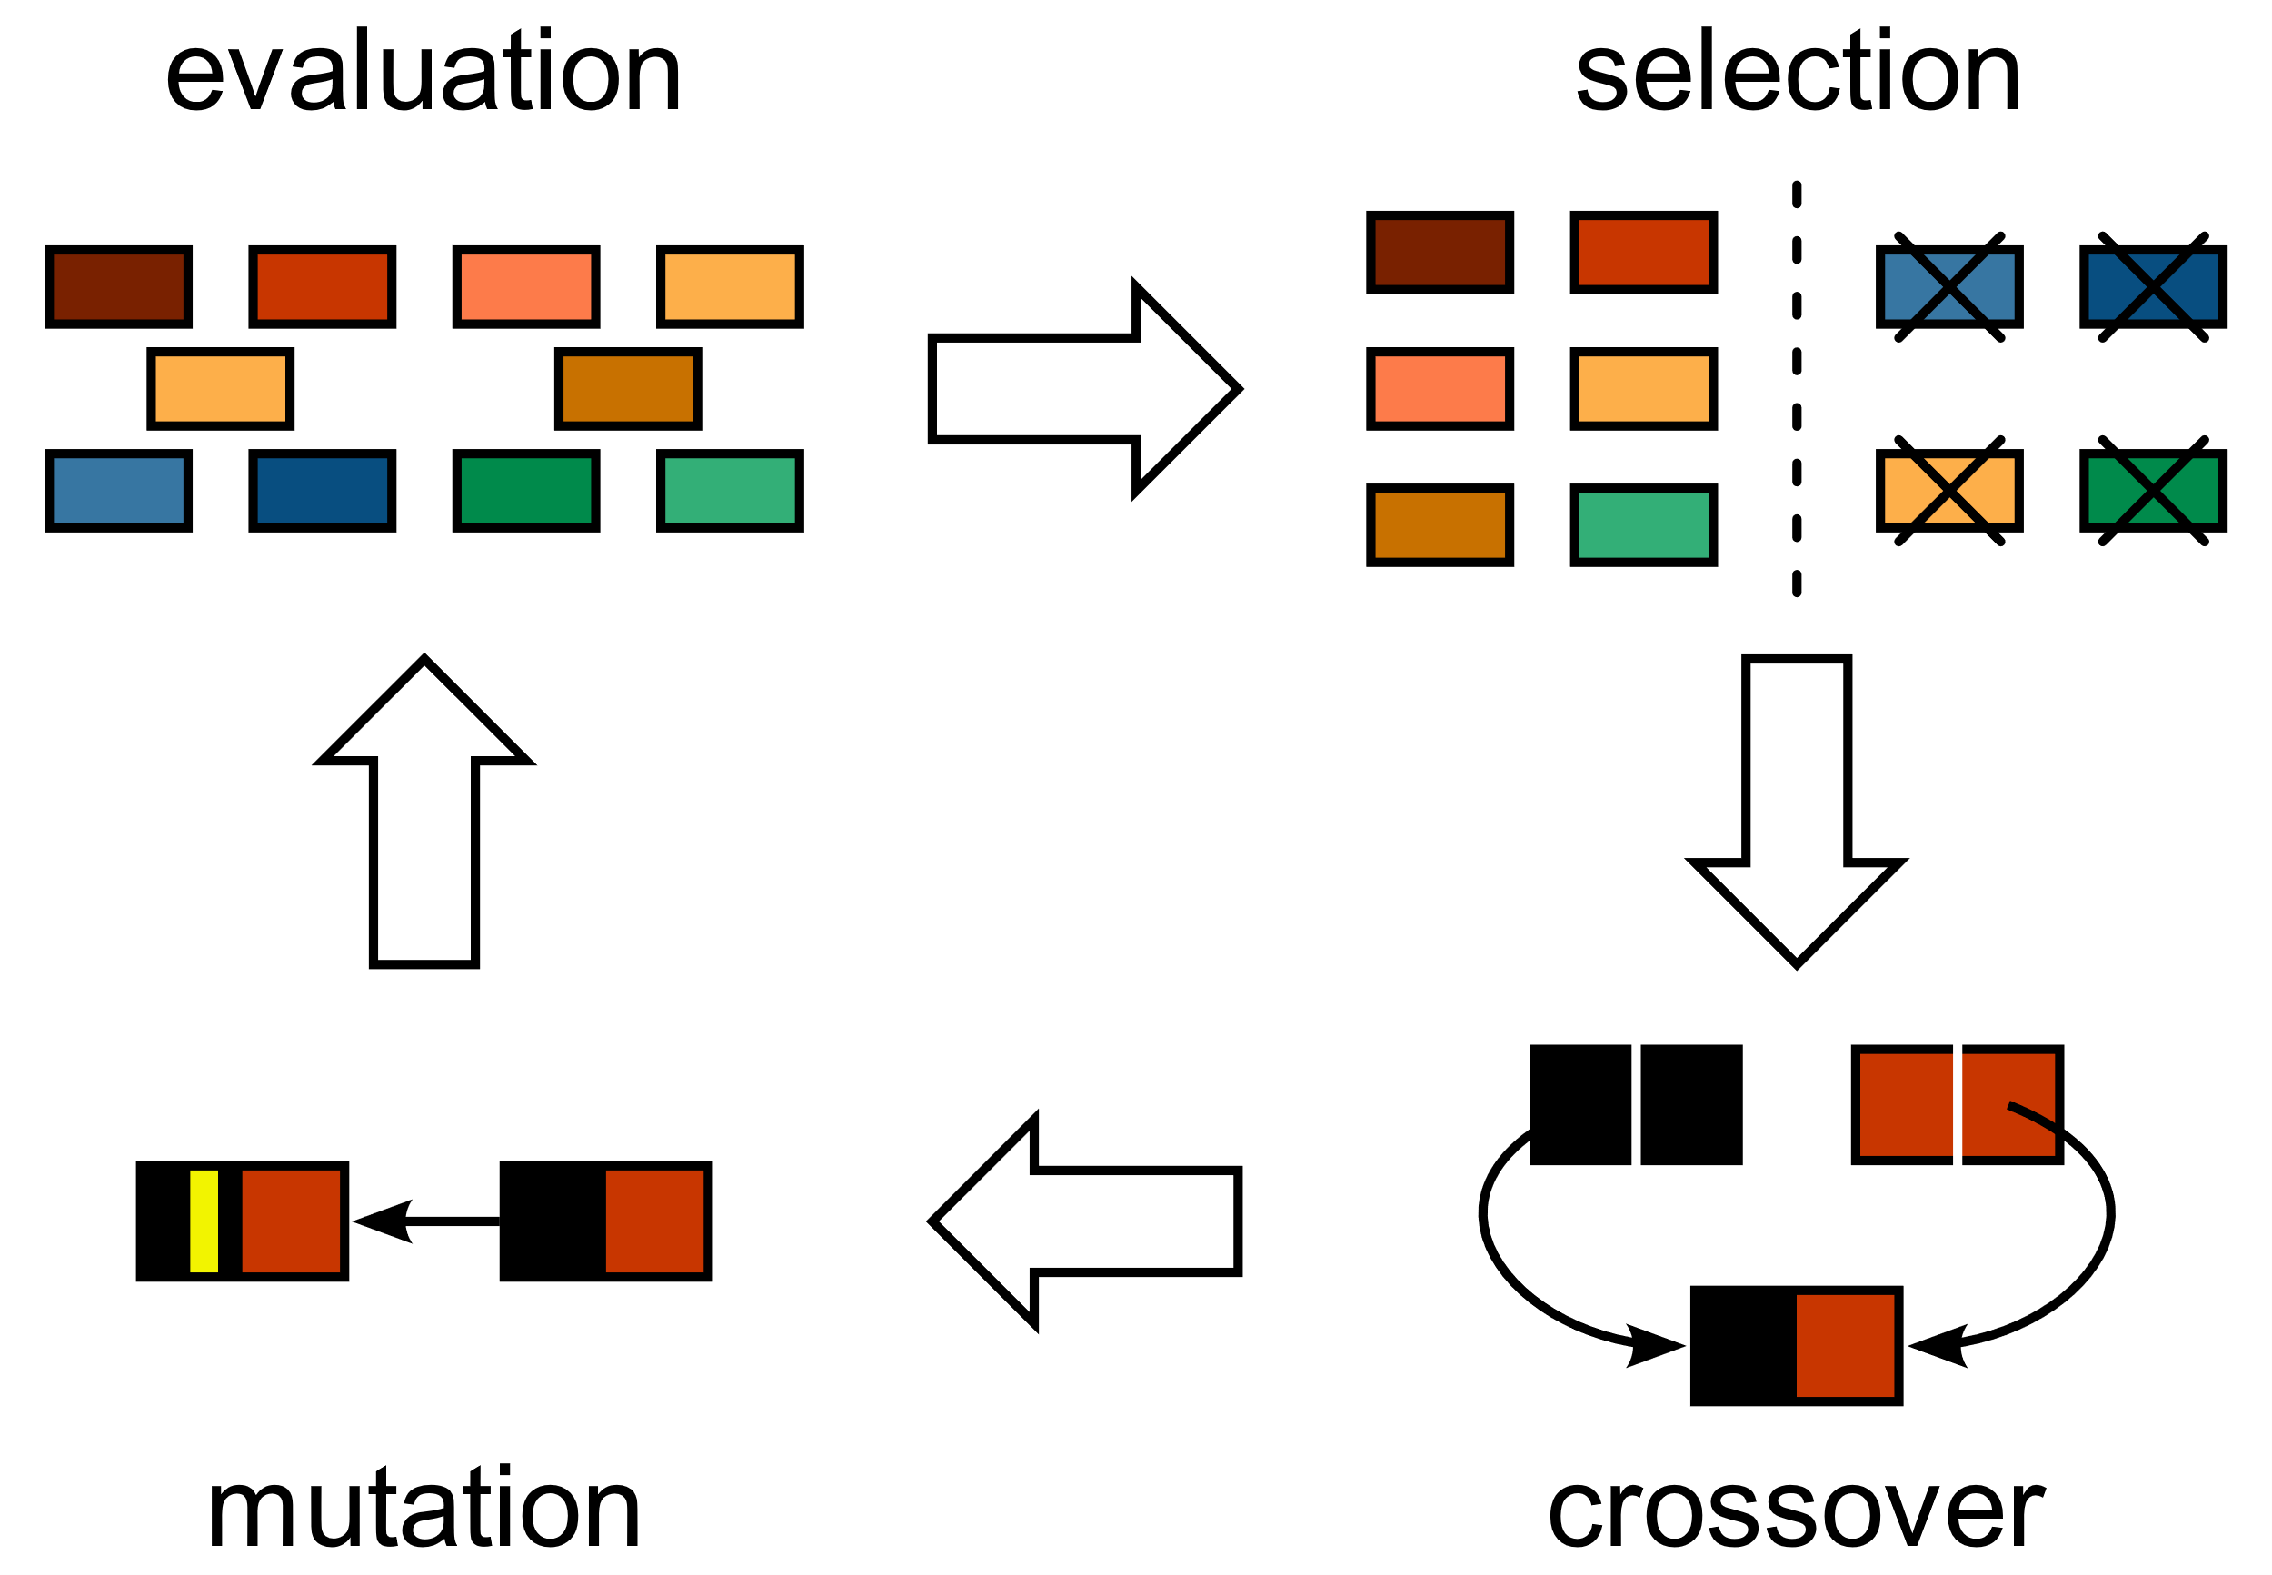
G-bot
This Photo by Unknown Author is licensed under CC BY-SA
Notes:
Explain the basic way it learns
LINDALEE

Slide 7
G-bot process
*Score stands for the best
individual’s average score
Genetic Neural Network
Genetic Algorithm
source:
TetNet, Idrees Hassan
Wider Field?
First Implementation
*score ~2000 over 10 games
Next Piece?
Additional Parameter
Old best move weight
Score ~5000 over 10 games
Testing
100 games average
Local minima?
Inconsistent performance
Risky strategies
Mutation changes
Tournament selection
Population size increase
Optimization
Training speed and games number
Score ~3000 over 30 games
Success!
Score ~5000 over 30 games
Experiment
Notes:
LINDALEE

Slide 8
Difference in field width: score
Notes:
SAMUELE

Slide 9
Difference in field width: holes
Notes:
SAMUELE

Slide 10
Difference in field width: roughness
Notes:
SAMUELE

Slide 11
Difference in field width: move influence
Notes:
SAMUELE

Slide 12
Difference in field width: rows cleared
Notes:
SAMUELE

Slide 13
Bot comparison
 | Q-bot | G-bot
Score | Unknown | 4500
Rows cleared | Unknown | 15
Time to train | None | High
Required processing power | High | Very low
‘Cleverness’ | Medium | High
Notes:
MAX

Slide 14

What we learned
Communication
Division of work
This Photo by Unknown Author is licensed under CC BY
Notes:
ANDREW

Slide 15

Planning phase 3
Visualization: week 1 and 2
Research: week 1
Implementation: end of week 1, start of week 2 and polish in week 3
Report: introduction, format, etc week 1, finish in week 3
Presentation: week 3
This Photo by Unknown Author is licensed under CC BY-SA
Notes:
ANDREW

